Slide 1
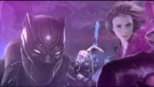
MARVEL Studios
-Skylar York
- Skylar York

Slide 2

What is MARVEL Studios?
MARVEL Studios big contender in the superhero franchise
Known for the MCU (MARVEL cinematic universe)
Known for it’s heroes like Spider-Man, Iron Man, Captain America, and many more
Owned by the Walt Disney company

Slide 3
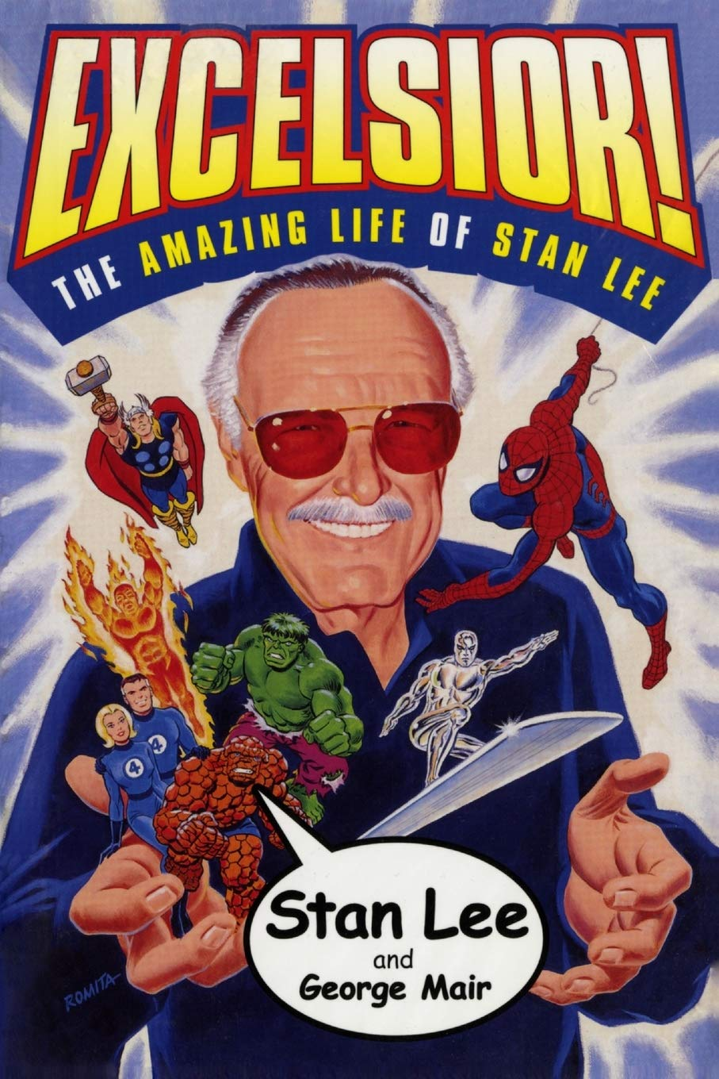
History of MARVEL
Started in 1939 by Martin Goodman
First known as Timely Comics
Marvel Comics no. 1 was the first ever MARVEL comic it introduced The Human Torch and Namor
Stan Lee and Jack Kirby was commissioned in the 1960s
First theatrical movie was Howard the Duck (1986)

Slide 4

What do they sell and how do they promote it?
Funko Pops, Lego Sets, Action figures, and more
Main distributer of toys/statues MARVEL Legends
Use the MARVEL main Facebook, Twitter, YouTube, and Twitch profiles to promote products
New item comes out ads are put onto different YouTube/Twitch channels to promote the product
Livestreams are held to show what the product does

Slide 5
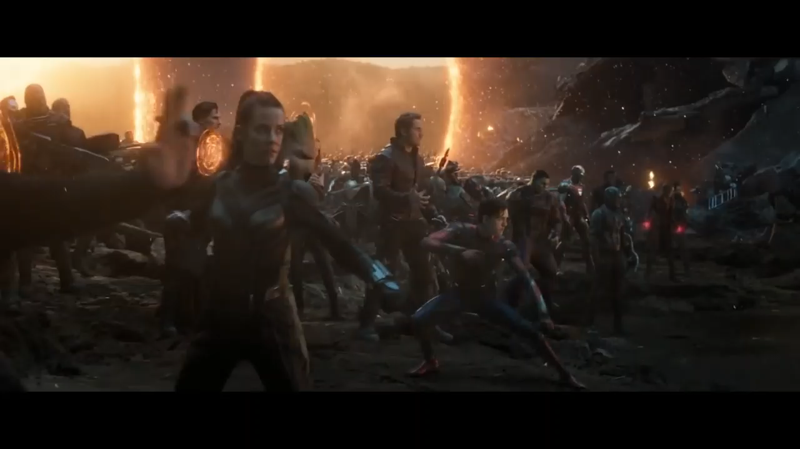
What is their social responsibility, mission statement, and goals? (or in this case what is their…)
Mission statement: “to have a vision as far-reaching as their stories, they want to expand their legends like Thor and The X-men to the point they resonate with past, current, and future generations”
Goals:
Brining in Spider-man and the X-men into the MCU
When first starting wanting to successfully setup an AVENGERS movie
Social Responsibility: MARVEL STUDIOS Hero Acts charity
Charity meant to raised money for kids with serious diseases
Announced by Sebastian Stan, Paul Bettany and Karen Gillian

Slide 6
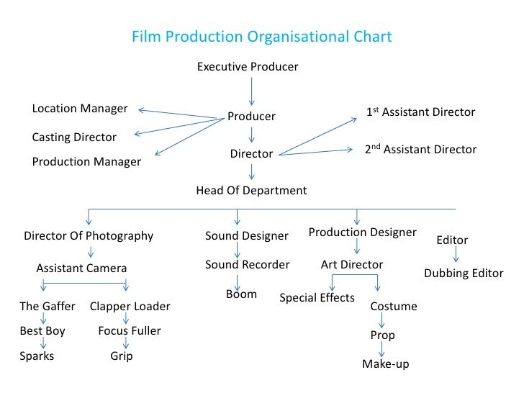
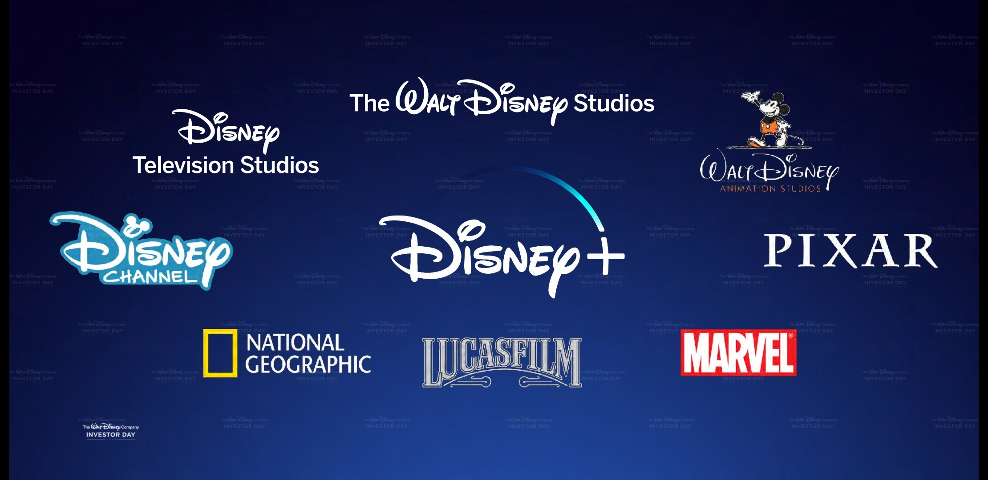
How is MARVEL structured?
Subsidiary of the Walt Disney company
Top management: Board of Directors and Disney
Middle management: Kevin Feige (CEO)
Supervisor management: Directors/Producers
Frontline workers: Actors, makeup artists, sound technician, film editors, etc.

Slide 7
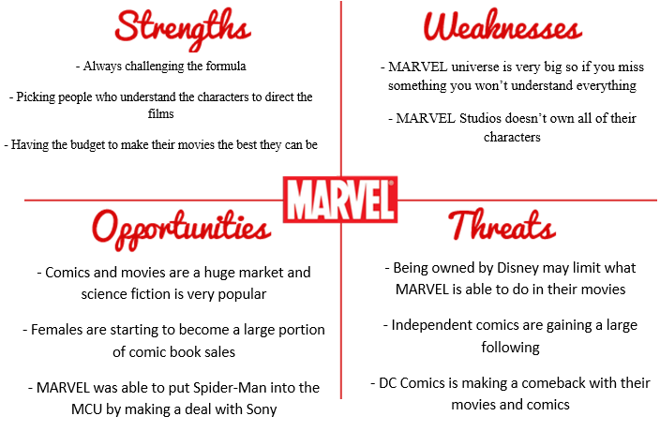
MARVEL’s SWOT Analysis

Slide 8

Job postings and what’s expected
DisneyCareers.com is the main job listing website for MARVEL
Job: Art Director for MARVEL Animation
Experience required: College degree or equivalent work experience (5-7 years)
Wanting the best of the best
Preferred qualifications: Positive attitude with the ability to be flexible
Wants to provide a positive work environment
Would I apply for MARVEL Studios: While I wouldn’t apply for the Art Director job, I would apply for something else like IT professional
Link to job offer: https://jobs.disneycareers.com/job/burbank/art-director-marvel-animation/391/17505544272

Slide 9
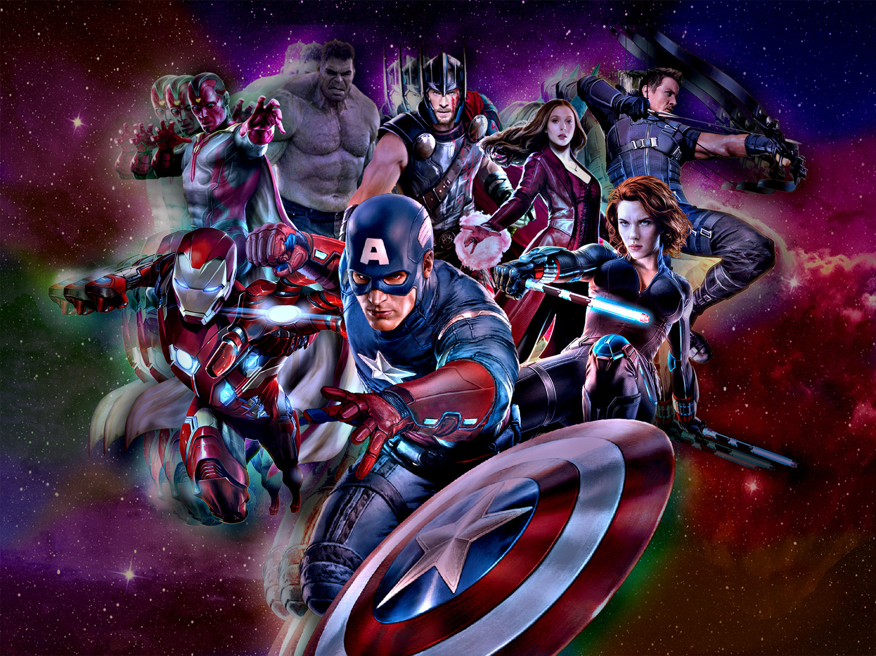
References
Clark, T. (2022, January 25). All 27 Marvel Cinematic Universe movies, ranked by how much money they made at the global box office. Business Insider. Retrieved January 29, 2022, from https://www.businessinsider.com/marvel-movies-ranked-how-much-money-at-global-box-office-2021-11?international=true&r=US&IR=T#3-spider-man-no-way-home-2021-25
DeForest, T. (n.d.). Marvel Comics | History, Characters, Facts, & Movies. Encyclopedia Britannica. Retrieved January 29, 2022, from https://www.britannica.com/topic/Marvel-Comics
Disney. (2021, November 2). Art Director - Marvel Animation. Disneycareers.Com. Retrieved February 11, 2022, from https://jobs.disneycareers.com/job/burbank/art-director-marvel-animation/391/17505544272
Dye, A. (2018, May 11). Marvel Studios: Hero Acts Will Donate 1.25 Million to Charities for Children. FanFest. Retrieved January 29, 2022, from https://fanfest.com/marvel-studios-hero-acts-will-donate-1-25-million-to-charities-for-children/
Harrison, S., Carlsen, A., & ŠKerlavaj, M. (2020, February 13). Marvel’s Blockbuster Machine. Harvard Business Review. Retrieved February 6, 2022, from https://hbr.org/2019/07/marvels-blockbuster-machine
Lally, M. (2019, October 10). Marvel Cinematic Universe: A lesson in employee engagement (Spoiler Free). Https://Www.Wearenova.Co.Uk. Retrieved February 6, 2022, from https://www.wearenova.co.uk/nova-blog/marvel-cinematic-universe-a-lesson-in-engagement-spoiler-free#:%7E:text=Marvel’s%20mission%20statement%3A%20%E2%80%9CA%20vision,Simple%20and%20yet%20incredibly%20ambitious.

Slide 10
The Avengers will return

